Slide 1
Fantasy Football Team Optimization
Project Proposal
24-785 Engineering Optimization
Jaydutt Kulkarni
Aditya Rathi
Aditya Joglekar
Jeffrey Wang

Slide 2
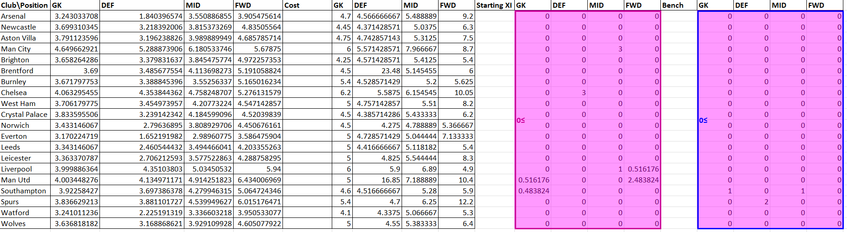
Excel solution - LP problem
GRG Nonlinear solver
Starting point - All zeros

Slide 3
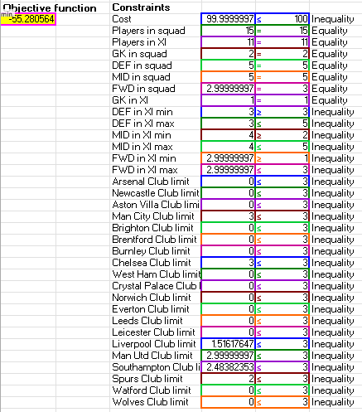
Excel solution - LP problem
GRG Nonlinear solver

Slide 4
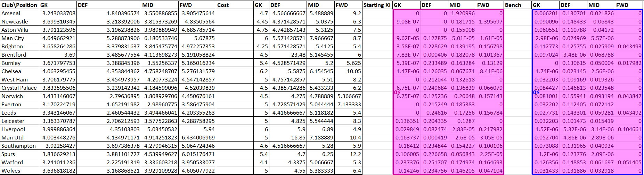
Excel solution - LP problem
GRG Nonlinear solver
Starting point - All ones

Slide 5
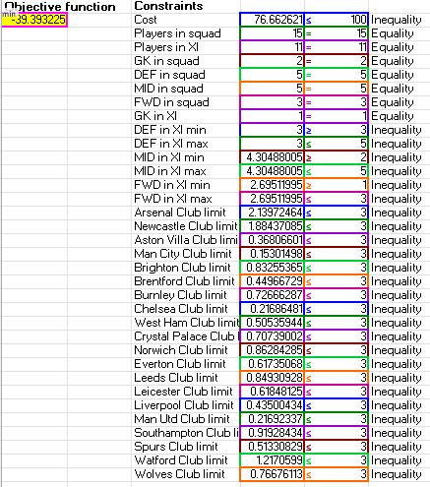
Excel solution - LP problem

Slide 6
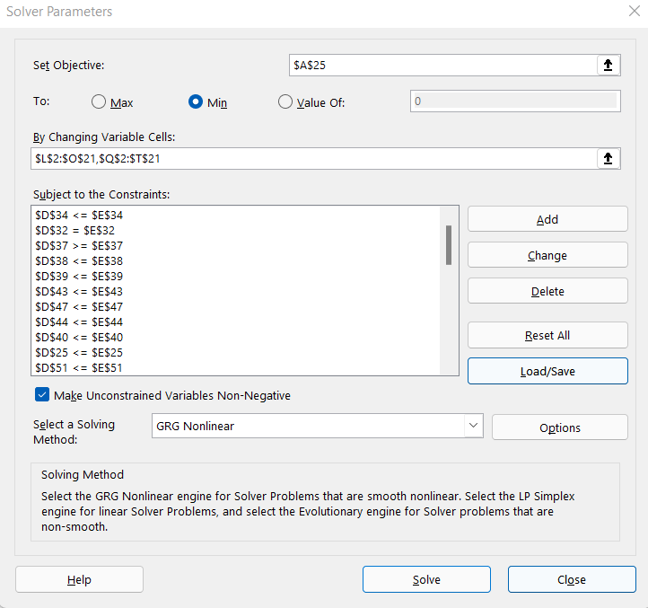
Excel solution - LP problem

Slide 7
Matlab LP
Results:
 | SQP | active-set | Interior point
X0 = zeros | -55.3593 | -55.0507 | -53.4074
X0 = ones | -55.2788 | -55.2301 | -53.2596
X0 = random | -55.2654 | -55.1432 | -52.8779
X0 = zeros, maxFunEval = inf | -55.3593 | -55.1039 | -54.6403

Slide 8
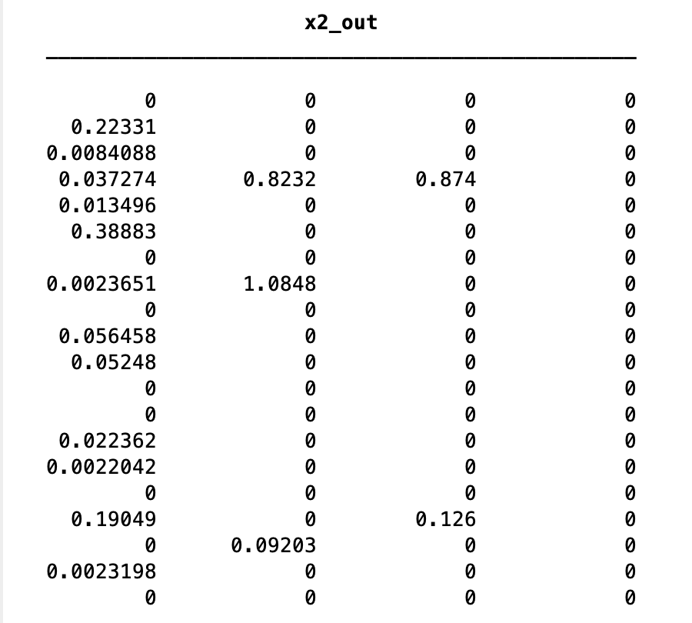
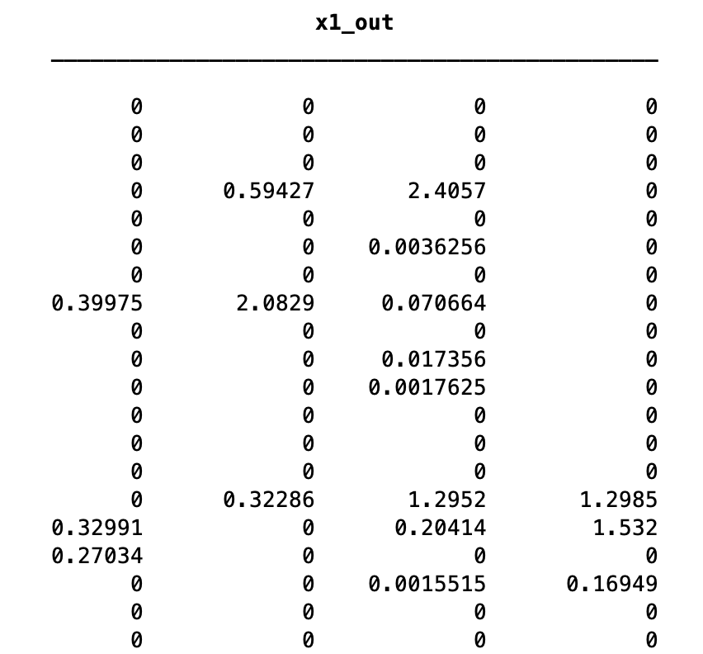
Active-set Zeros LP Results

Slide 9
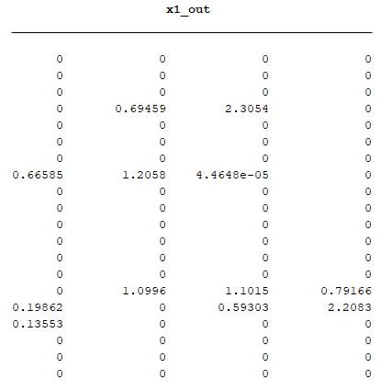
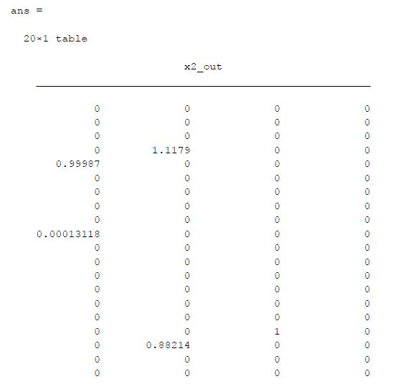
SQP Random initialization LP Results

Slide 10
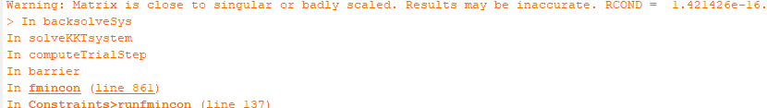
Warning for Interior Point Method

Slide 11
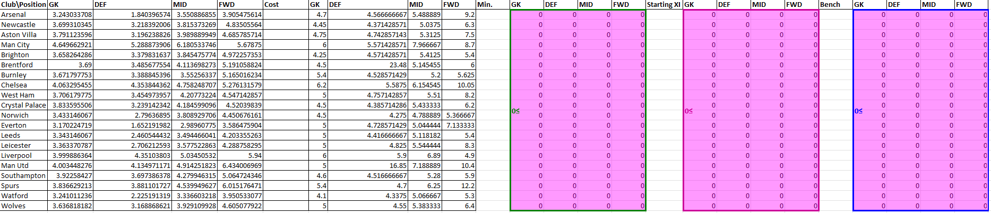
Excel solution - NLP problem

Slide 12
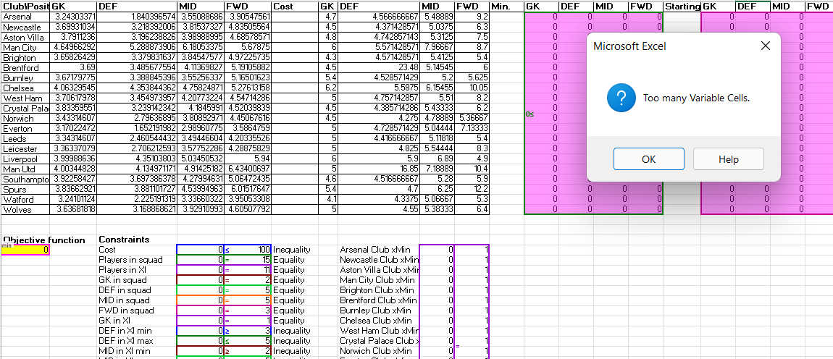
Excel solution - NLP problem

